Slide 1
CUSTOMER REVIEW CLASSIFICATION USING NATURAL LANGUAGE PROCESSING
DATA606 Capstone Data Science
Bhanu Harish Surisetti
Jessie Caroline Merugu
Sreeja Pendota

Slide 2
Aim of the project
The objective of the project is to use NLP and machine learning techniques to predict customer satisfaction level with products based on their reviews.
In this project we will use NLP and machine learning techniques to predict the fake reviews based on the review text.

Slide 3
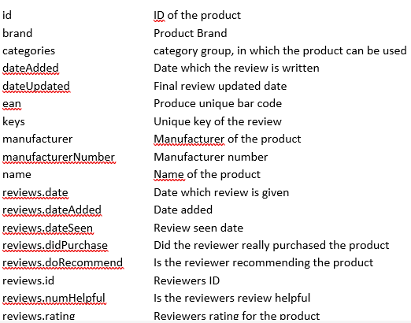
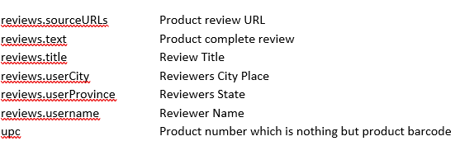
Data Source
https://www.kaggle.com/code/duttadebadri/detailed-nlp-project-prediction-visualization/data
Size of the Data Set: 99.44MB
Rows : 71044
Columns : 25

Slide 4
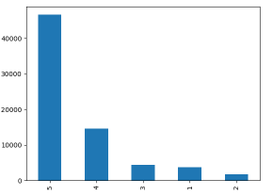
Exploratory Data Analysis
It can be observed that within the range of ratings from 1 to 5,the frequency of reviews is at its lowest point for a rating of 2.
One can note that the frequency of reviews is highest for a rating of 5 within the range of ratings from 1 to 5.

Slide 5
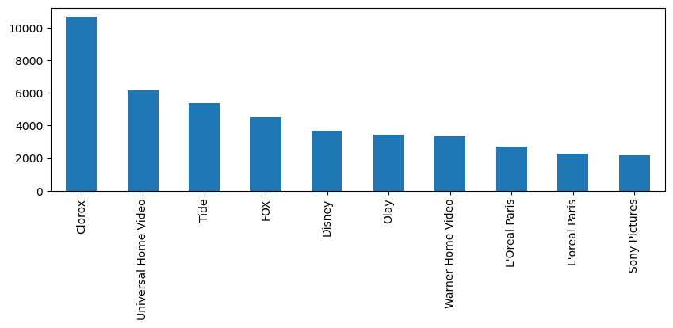
EDA
It is evident that Clorox stands out as a leading brand, outperforming other brands with its high customer ratings and maximum sales figures
Universal Home Video holds the position of the second most recognized brand on a scale of 1 to 10 brands.

Slide 6
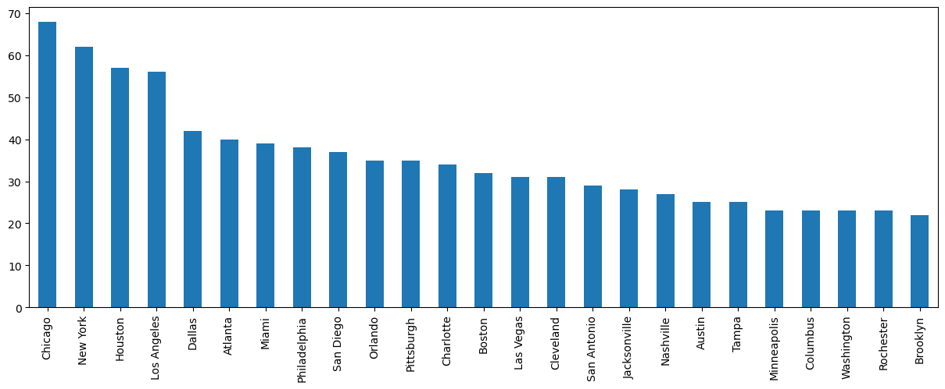
EDA
In the case of Chicago, it is evident that people are highly engaged in reviewing product details and rating the products they have purchased from the brand's various categories.

Slide 7
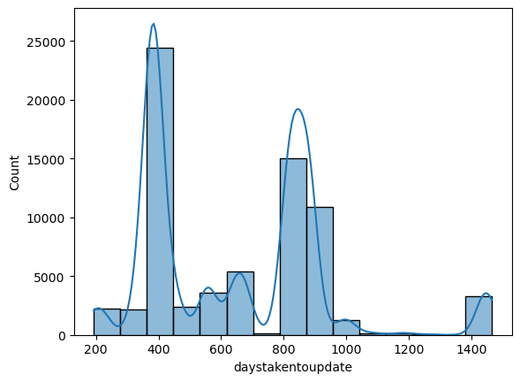
EDA
Currently, the range between 300 and 400 contains the highest amount of products that receive frequent updates.
Based on the plot above, it can be inferred that products typically begin receiving updates after a period of 200 days.
Overall, there exist certain products that receive updates after a duration of 1300 days.
On average, the products undergo updates within the range of 700 to 900 days.
It can be observed that, people were taking around 400 days to update their review.
The second highest time gap taken to update the review is around 800 days.

Slide 8
Further EDA and Machine Learning Algorithms
EDA will be performed to analyze the correlation between review rating and the number of words used in the review text, as well as to visualize which words are used most and check if there is any regional impact on the reviews provided.
The project also plans to use future classifiers such as Naïve Bayes Classifier, KNN, and XLNet to improve accuracy. Overall, the project seeks to use NLP and machine learning to better understand customer satisfaction and to identify factors that influence it.

Slide 9
Reference
https://www.projectpro.io/article/machine-learning-nlp-text-classification-algorithms-and-models/523

